Slide 1
EXTREME PAINTBALL PARK
Produced by: Academy Student, Zach Baker. A student with Hope & Peace.

Slide 2
Can you play at your house?
No you are not allowed to play paintball in your front yard. There are places that have fields where you can play.

Slide 3
Play at nearby courts!
Use your paintball gun on a court. It is the safest place to use your paintball gun.

Slide 4
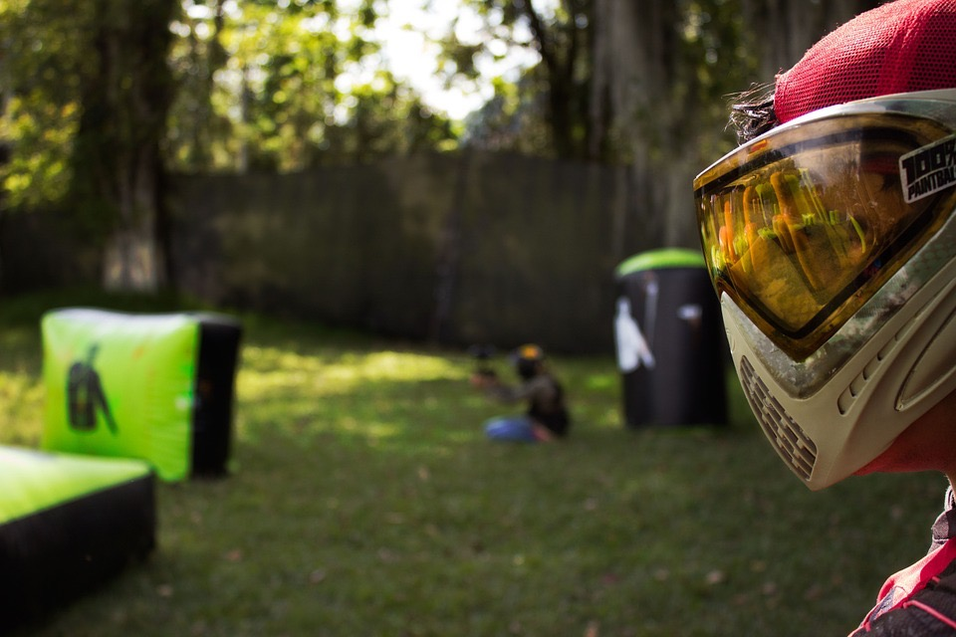
Fly balls!
Fly balls are paintballs that hit you but don’t explode. The paintball has to explode in order to be counted as a hit.

Slide 5
How do you start?
New players have to play free play (FP). Free play is where new players play each other so it's fair.

Slide 6
Can any kid play paintball?
Yes! They can play free play as long as they have their parent’s or guardian's permission. ( Guardian MUST BE 18 or older.)

Slide 7
Call your hits!
You must raise your hand when you are hit by paintballs. If you do not call your hits, you may get a warning or you can get banned from the park for a certain period of time.

Slide 8
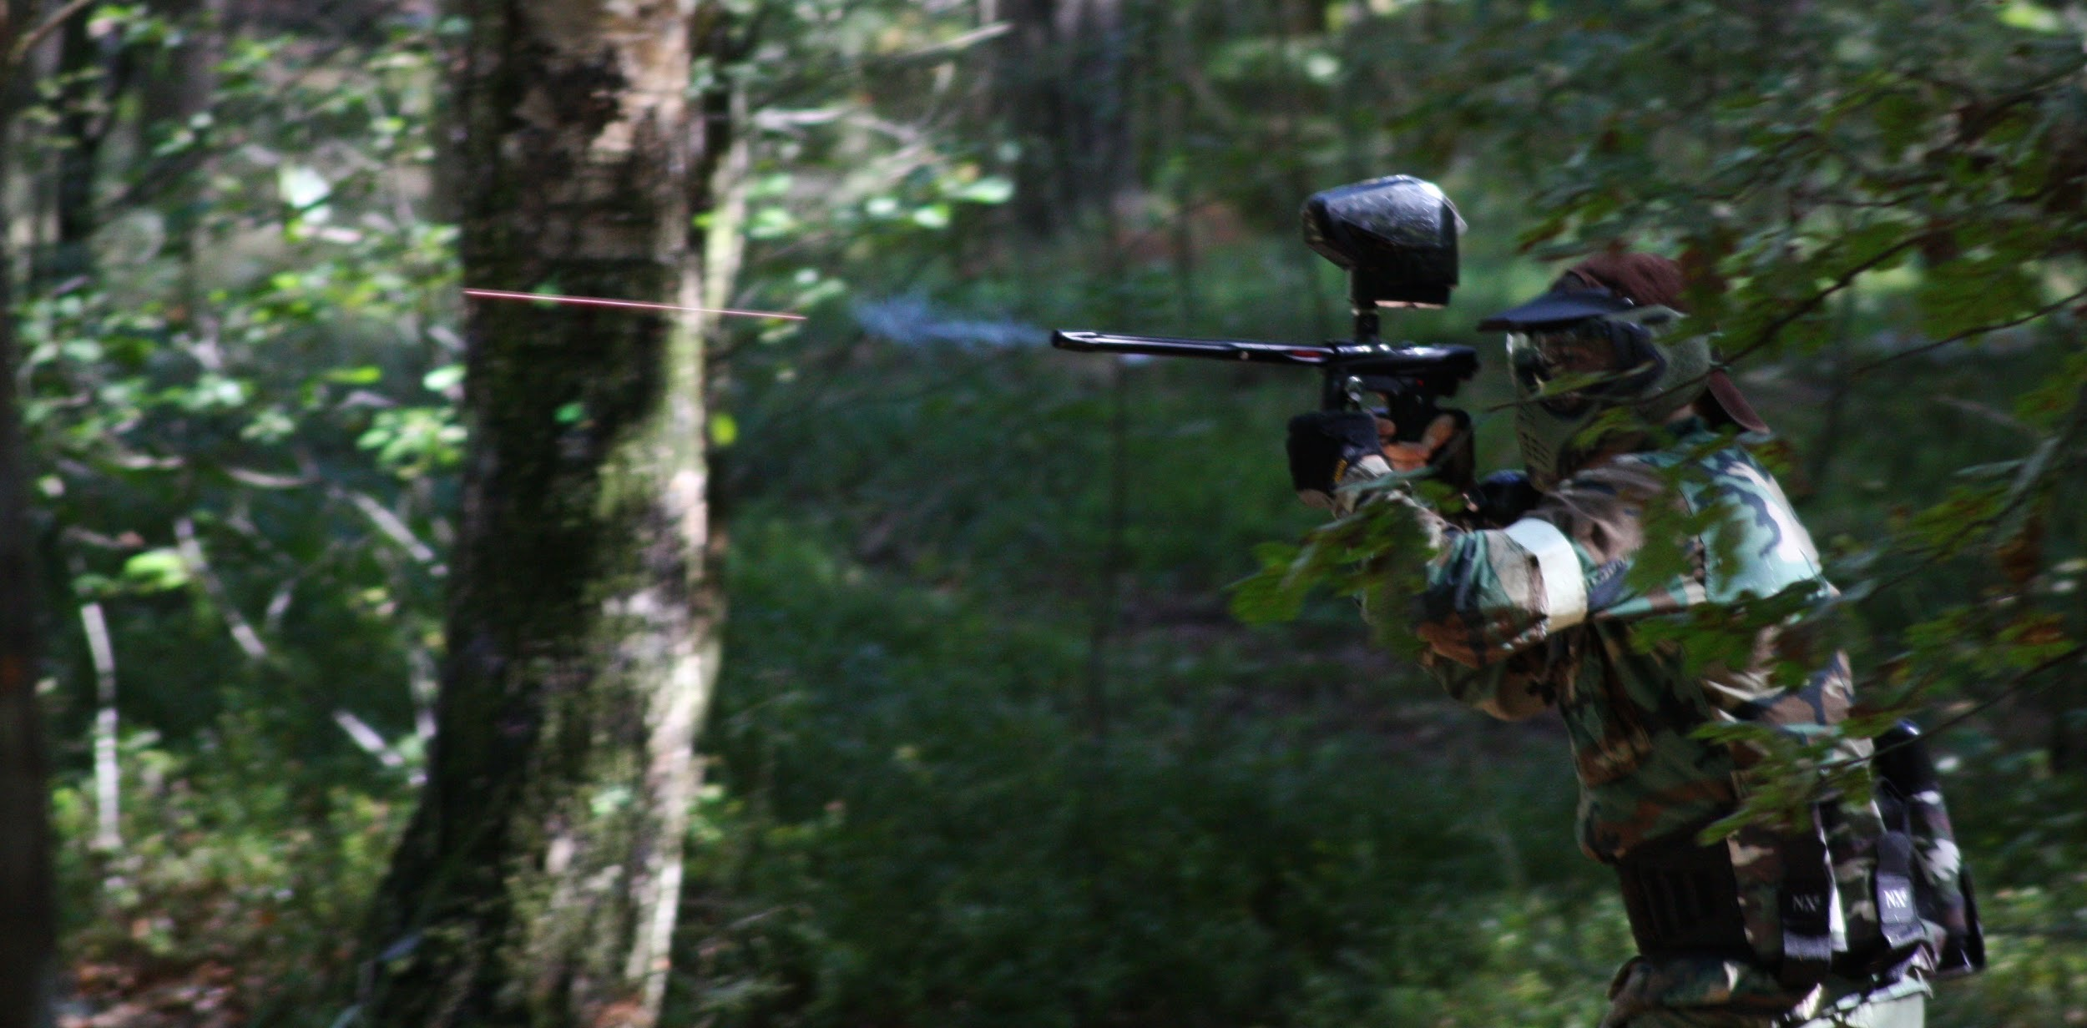
How do you start the game?
Each team or individual player takes a side of the field.

Slide 9
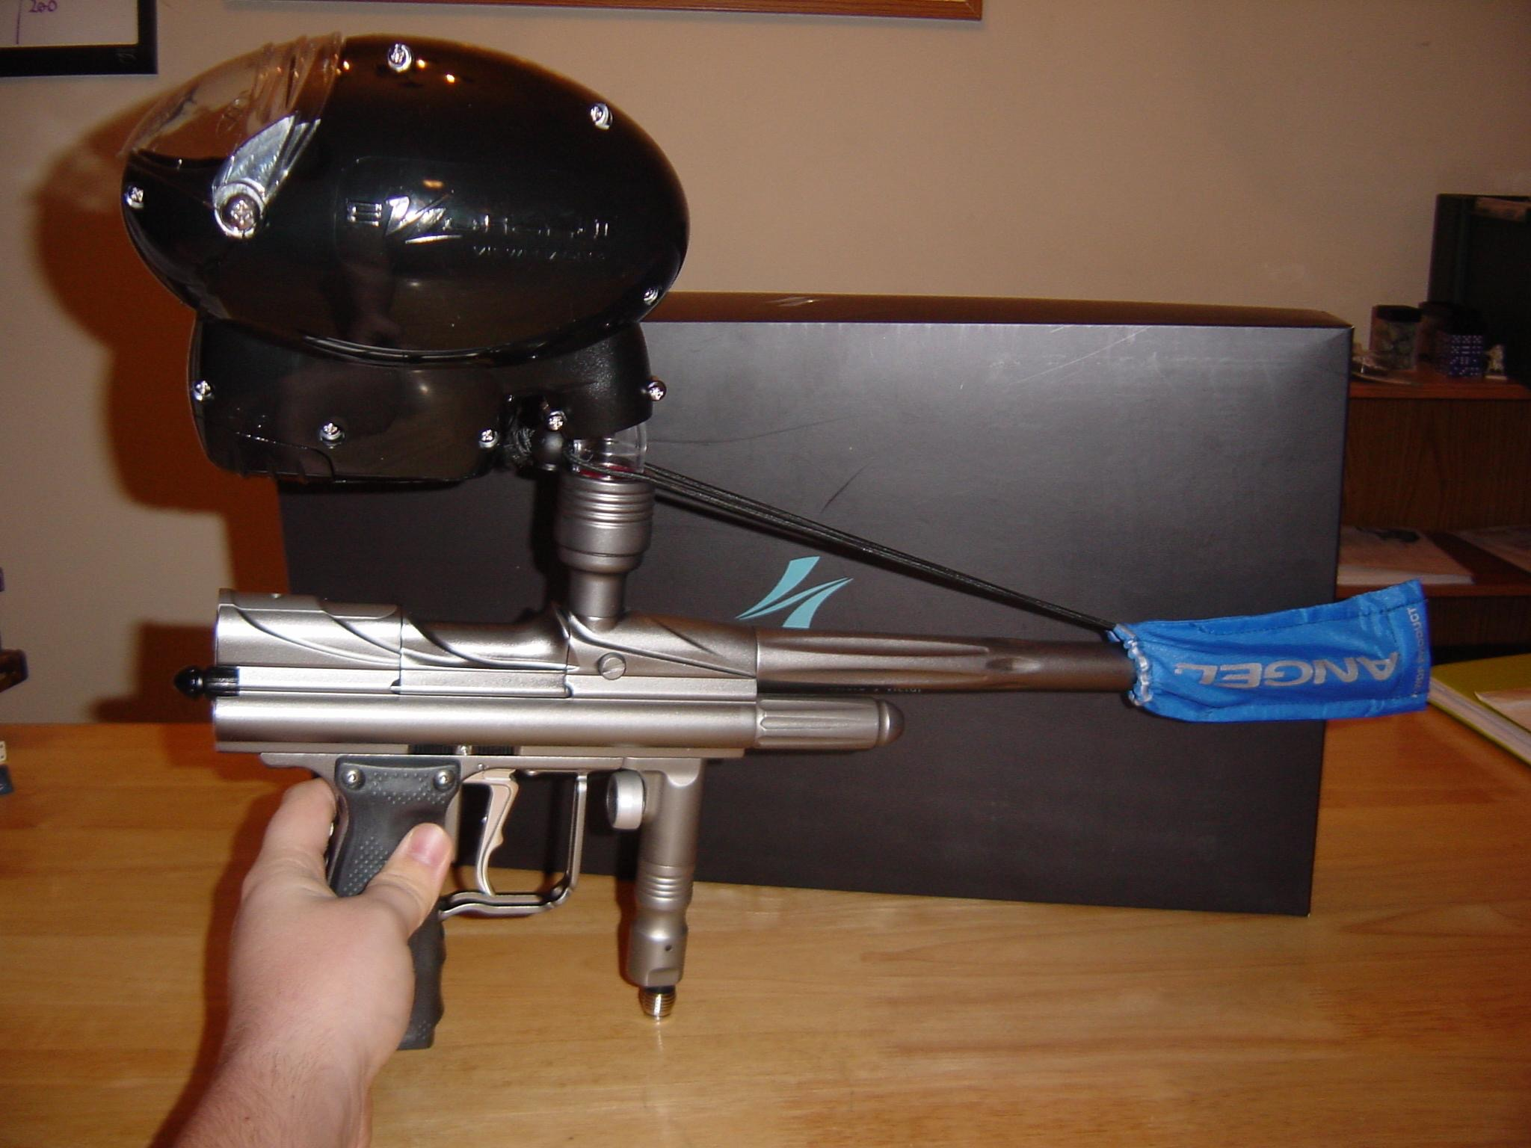
Can you rent a paintball gun?
Yes! Every court rents paintball guns.

Slide 10
Laws for paintball in the state of Missouri
Never play paintball on land you do not have the permission of the owner to play on. THIS INCLUDES PUBLIC LAND like parks, state forests, etc. If you don't have permission to play from the owner of the land you are on, you are not allowed to play there, public land or otherwise.
When transporting a paintball marker, disassemble the marker to the greatest degree possible, and always do so with the marker unloaded. Remove the hopper, barrel, and air tank, if possible, and make sure no paint remains in the chamber.
Never carry a paintball marker in plain sight in public areas. Not everyone will recognize a paintball marker at first glance. If you need to take your marker from point A to point B, put it in a bag or carrying case.
Avoid having a paintball marker in the passenger section of your car.

Slide 11
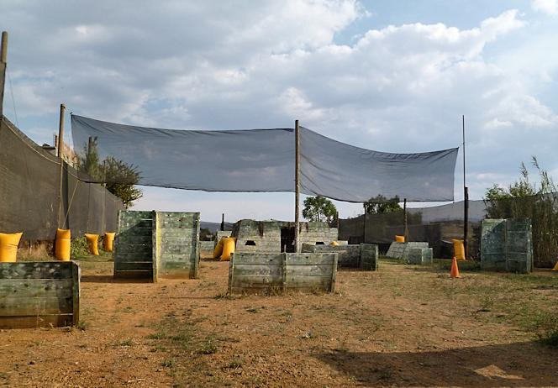
Can you quit paintball?
When you sign the waiver, you are expected to finish the game that you start.

Slide 12
Can you step out of a game?
You can step out of a game if you have a serious reason; for instance, if you are injured or cannot breath. If this happens, you may step out of the current game, raise your hand and take your mask off. `

Slide 13
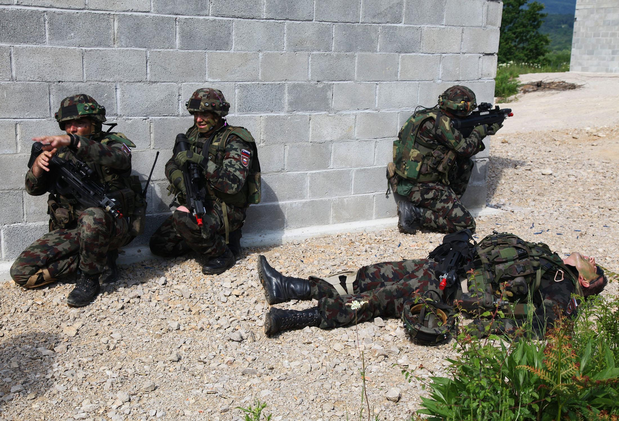
Can you leave during a game?
If you are injured you will need to leave the game but the paintball park will not be responsible for your injury. They make you sign a release before you can play.

Slide 14
How much does it cost to play?
The cost for playing is $40 per person. They do not charge per hour so you can play as long as you want. They also charge money for paintballs if you do not bring your own.

Slide 15
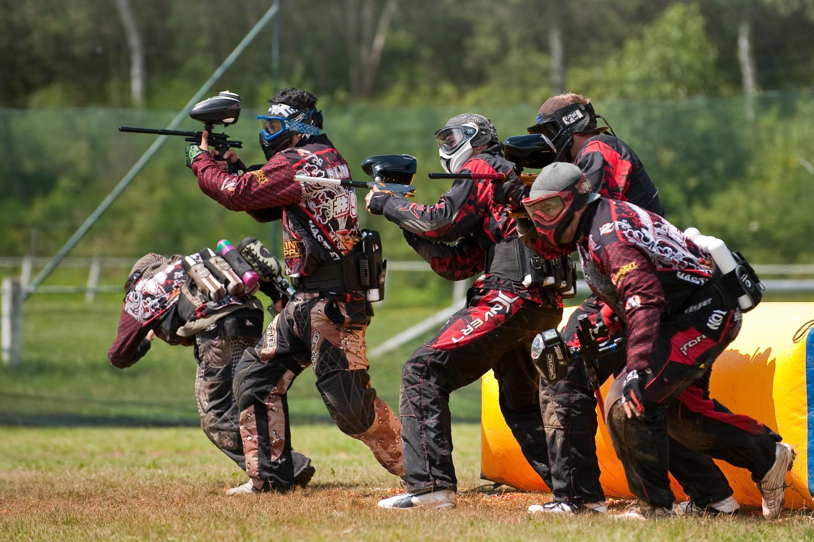
How can I join a team?
Joining a team is as easy as a phone call. You need to call the park and ask if there are any teams that need players. You will have to try out for the team so you will be on the team that matches your skill level. It takes a lot of time and practice to improve your skills.

Slide 16
How much is it for a player ?
It will cost each player between $40 and $50 dollars depending on how many players there are.

Slide 17
How much do paintballs hurt?

Slide 18
Can you record a paintball game ?
You can use a GoPro to record your game but using your phone is not allowed.

Slide 19
Can you reserve the field for a private group?
Yes. Just call them and they will set up a party for you. It will cost a little more but it will only be your friends playing.

Slide 20
Can you spray paint a paintball gun?
You can but you shouldn't because it could break the gun.

Slide 21
HAUNTED paintball ride!?
Some parks offer special paintball events. Haunted paintball ride is where zombies are chasing you and you have to hit them with paintballs!

Slide 22
When is haunted paintball?
Zombie paintball is only available during Halloween time. The field is decorated especially for this event.

Slide 23
All parks have different rules so make sure you know the rules before you play!

Slide 24
For more information or to set up a time to play paintball call:
XTREME PAINTBALL PARK 618-476-9273

Slide 25
EXTREME PAINTBALL PARK
CREATED by zach
Academy of St. Louis Student

Slide 26
A student with
and

